Slide 1
Quarter 3 District Writing Essay

Slide 2
During This Quarter

Slide 3
Prompt
Think back to the articles we read for our Person/Hero of the Year Unit. How did the author use language to make you feel, think or act in a certain way?
"Man in the Water" (Real life stories)
"Parable of the Good Samaritan" (Words from the Bible to help you act correctly)
“The Nothing Man” (This was a song)
“Disturbing Legacy of Rescues” (Used real life stories that made you really think about what rescues workers really do. That is not “glamourous” like people believe it to be.)
What does this really mean:
I have to write an essay where I explain how authors use his or her words to impact, inspire, influence the reader to act, think, or feel. I use three written pieces as support.

Slide 5
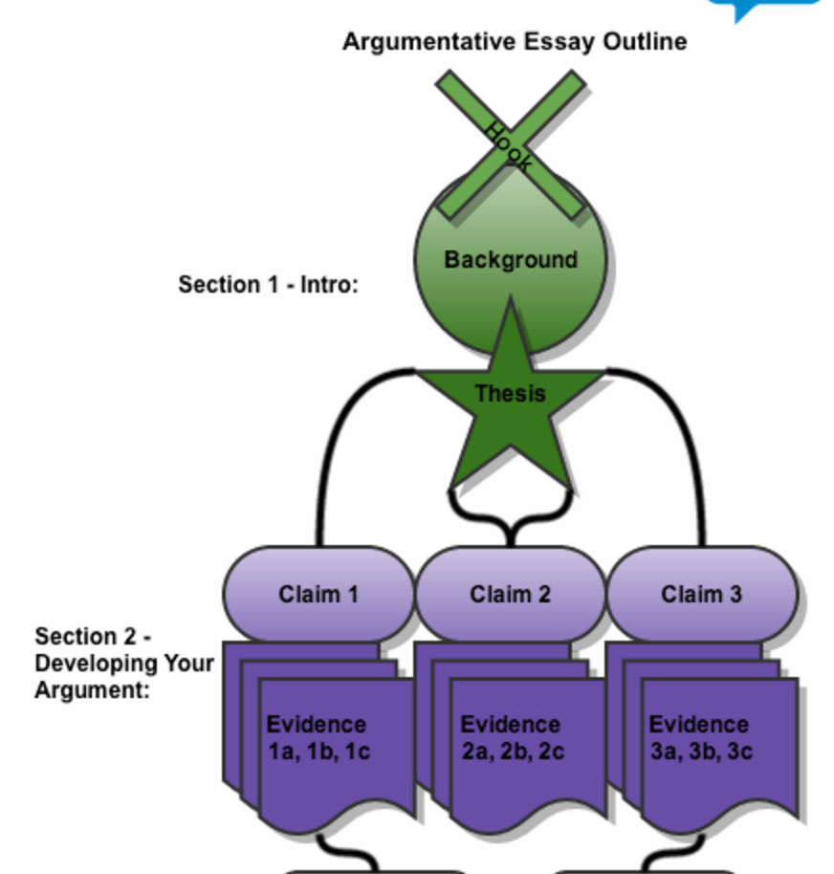
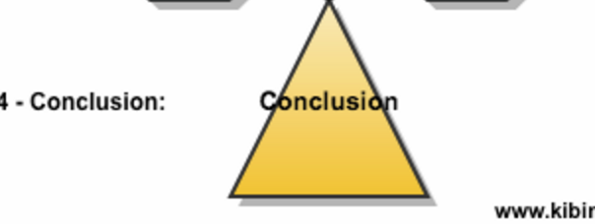
Argument Essay Format

Slide 6
Introduction
https://www.kibin.com/essay-writing-blog/argumentative-essay-outline/

Slide 7
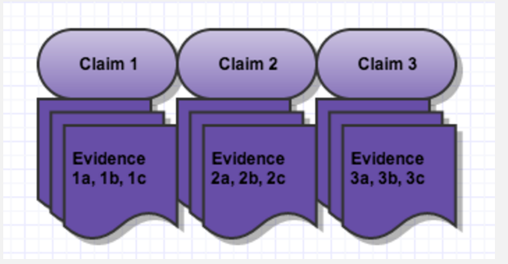
Developing your Argument
https://www.kibin.com/essay-writing-blog/argumentative-essay-outline/

Slide 8
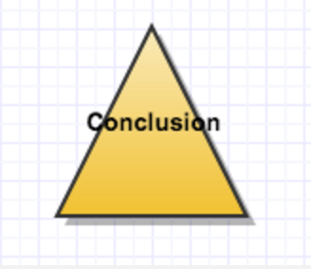
Conclusion
https://www.kibin.com/essay-writing-blog/argumentative-essay-outline/

Slide 9
