Slide 1
By ERICH MARIA REMARQUE
All Quiet on the Western Front

Slide 2
By ERICH MARIA REMARQUE
All Quiet on the Western Front
“This book is to be neither an accusation nor a confession, and least of all an adventure, for death is not an adventure to those who stand face to face with it. It will try simply to tell of a generation of men who, even though they may have escaped its shells, were destroyed by the war.” (Remarque 6)

Slide 3
Anticipation Guide
Complete the following Anticipation Guide by placing an “A” if you agree with the statement or a “D” if you disagree with the statement.
Sometimes war is the only way for conflicting countries to solve their problems____
No one under 20 should be allowed to fight for their country ____
Killing is wrong no matter what the situation is ____
4) Political leaders are the only ones responsible for war ____
5) Your country is worth dying for ____
6) It is unpatriotic to question your nation’s leaders____
7) You would fight for your friends and family before fighting for your country____
8) If war is declared, it is your duty to support your country in any way you can_____

Slide 4
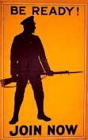
Chapter 1
1. Where are the men “at rest”?
2. Why is there such an abundance of rations?
3. Who is the narrator? How old is he?
4. What is symbolic about Leer’s name?
5. Why do the men feel hostile toward Ginger?
6. What is Muller’s plan for Kemmerich’s boots? Do you think this is cruel?
Five miles behind the front
Miscalculation – did not count on so much of a lose of life on the front.
Paul Bäumer – 19 years old
Leer means to have a lustful or sly look as Leer does.
He resists in giving them the extra rations and continually makes them come back from the fighting to get their own food whereas other cooks bring it up to the men at the front.
Muller plans to keep Kemmerich’s boots for himself. This could be considered cruel because Muller is more concentrated on the boots, but the reality of it is that they see so much death out there, and for Muller to survive, he must look out for his own needs well beyond Kemmerich’s death.

Slide 5
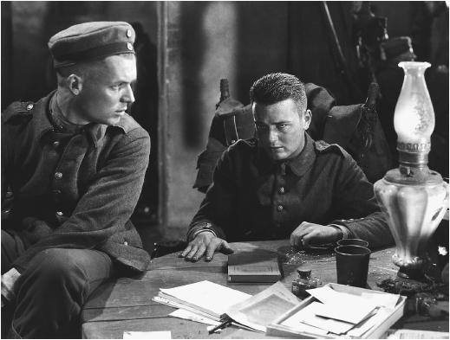
Themes Chapter 1
"The soldier is on friendlier terms than other men with his stomach and intestines. Three-quarters of his vocabulary is derived from these regions, and they give an intimate flavour to expressions of his greatest joy as well as of his deepest indignation. It is impossible to express oneself in any other way so clearly and pithily. Our families and our teachers will be shocked when we go home, but here it is the universal language."
Themes
Loss of Innocence
Truths of War
Hopes, Dreams, Plans
Death
Sacrifice
Primitiveness

Slide 6
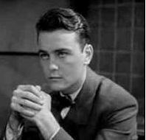
Themes Chapter 1
"The wisest were just the poor and simple people. They knew the war to be a misfortune, whereas those who were better off, and should have been able to see more clearly what the consequences would be, were beside themselves with joy. Katczinsky said that was a result of their upbringing. It made them stupid. And what Kat said, he had thought about."
Themes
Loss of Innocence
Truths of War
Hopes, Dreams, Plans
Death
Sacrifice
Primitiveness

Slide 7
Chapter 2 Questions preview
Chapter 2 1. Why does Paul refer to his generation as a “waste land”?
Because they have left the connections of their families without making new families or aspirations. The time of their life that is supposed to be formed through experiences of love, family, and success has only been tainted by war. 2. Who is Corporal Himmelstoss?
He is the leader of No.9 platoon in which all of the boys/men previously described are stationed. In civilian life, he was a postman, and he often gives Tjaden and Paul a hard time/extra ridiculous commands to complete. 3. What prejudice does Paul have against small men? Why?
Paul does not like small men because he believes that they try to make up for their lack in size with the power that they are given. They wield the power in a very unhealthy way, taking out their lifetime of feeling small on those who aren’t weak and small as they are. 4. How do Paul and Kropp get revenge on Himmelstoss?
They wait until the end of their training, and then they wait to “attack” him as he leaves a bar one night. Because he is drunk and distracted by his own singing, Himmelstoss does not see they boys as they come up behind him, put a sheet over his head, hit him, pull his drawers down and whip him on the buttocks.

Slide 8
Chapter 2 Questions
5. According to Paul, what is the finest thing to arise from the war? COMERADESHIP 6. What makes Kemmerich’s death so personal for Paul?
They grew up together. 7. What is significant about Kemmerich’s telling Paul to take the boots for Muller?
It shows that Kemmerich understands that he is going to die, and that Muller meant no harm in asking for the boots, it is merely a necessity for survival on the front. 8. Describe the character of Paul from what you have learned in the first two chapters.
He is caring, a loyal friend, marred by what he has found the world to be, brave, survivor, fun…(find passages in the first two chapters that support this). 9. Kemmerich’s death illustrates part of the central message of the novel. Do you have an idea of what this message is?
War destroys innocence, steals life, and concerns itself with nothing, not even the individual. War steals from the innocent and gives to the whole. ETC.

Slide 9
Chapter 2 – How have the men changed?
Kantorek would say that we stood on the threshold of life. And so it would seem. We had as yet taken no root. The war swept us away. For the others, the older men, it is but an interruption. They are able to think beyond it. We, however, have been gripped by it and do not know what the end may be. We know only that in some strange and melancholy way we have become a waste land. All the same, we are not often sad. (20)
Word Bank
Underline Figurative Language above. Circle 1 word per line that relates to Mood below.
Light-hearted Tense Playful Resigned Confused Violent Enlightened Insidious Optimistic Pessimistic Liberating Confining Warm Cold Hopeful Hopeless Nostalgic Haunting Peaceful Regretful Welcoming Hostile Harmonious Ambivalent Bitter Foreboding Awkward Painful

Slide 10
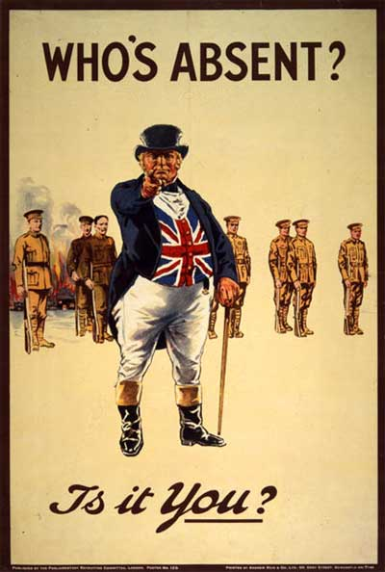
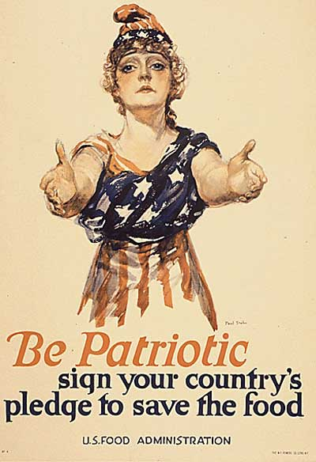
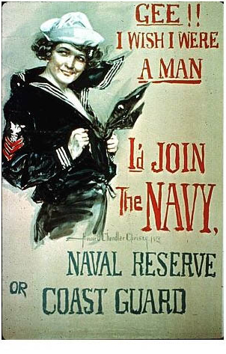
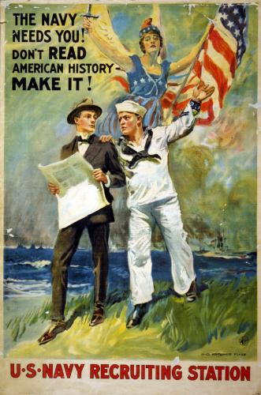
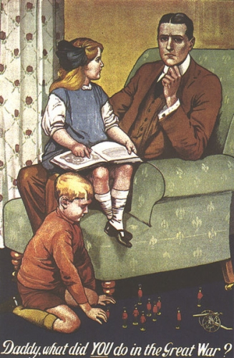
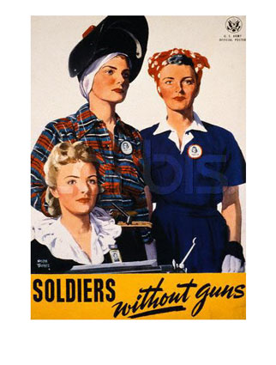
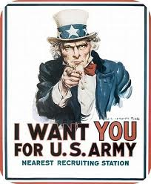
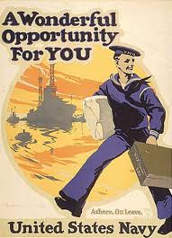
Chapter 3 - WW I Propaganda Journal:
Which poster is the most effective? Why?

Slide 11
Chapter 3
Why is it ironic that Paul and his comrades refer to themselves as “stone-age veterans” when they compare themselves to the new recruits?
Describe Katczinsky. What is his special talent?.
They are only about a year older and only a few months more on the front than the new recruits.
He is very street smart. In civilian life he is a cobbler, but understands most trades. Special Talent = He can find food anywhere.

Slide 12
Chapter 3
3. What is Kat’s philosophy of war? hat is Kropp’s philosophy of war?
4. What is Kropp’s philosophy concerning power given to insignificant men?
That the hierarchical organization (and pay) of the army drags the war on unnecessarily (see the rhyme on pg. 41). That if you could just set the two leaders to fighting and then declare the winner’s country the winner of the war, war would be more just because the “right” people would do the fighting.
That since they are insignificant, when they get power, they abuse it.

Slide 13
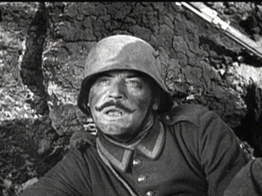
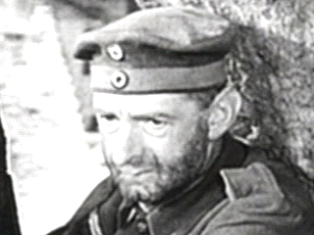
Chapter 3
5. Who is coming to the front? Why do these men strongly anticipate his arrival?
Himmelstoss. Because of the way that he mistreated them in the barracks – especially the bed-wetter - Tjaden.
VS.

Slide 14
Chapter 4
Why are Paul and his comrades sent to the front?
How do the men change as they approach the front?. Why is this change necessary?
They are back up.
They get more and more fidgety (especially the new recruits), more serious. They need to get more serious, more aware of the danger of the front, more concentrated.

Slide 15
Chapter 4
How do Paul and his comrades manage to save themselves from the shelling? From the gas attack?
. What happens to the young soldier that Paul helped at the beginning of the chapter? What do Paul and Kat wish to do for him? Why don’t they do it?
They dive into a hole that has been created by being shelled, but they end up next to corpses because they are in a graveyard. By helping each other to put on their gas masks (especially the recruits).
He gets injured when a coffin lands on top of him after it is blown up by shelling. To put him out of his misery – shoot him, just as Detering wanted to do to the horses (again emphasizes the loss of their humanity and animal instincts). Others begin to gather around as they appear from the trenches.

Slide 16
Chapter 5
1. Why, can’t the men get rid of their lice?
2. Why has Himmelstoss been sent to the front?
Because they have hundreds on each of their heads.
Because he overdid his “lessons” of a few young recruits, and the son of the local magistrate saw and reported him.

Slide 17
Chapter 5
3. How do the men treat Himmeistoss?
4. How does Tjaden get in trouble with Himmelstoss?
They don’t show him any respect. In fact, they are very disrespectful.
He treats him as any other soldier, not a superior. He calls him a dirty hound. Because Paul tells the story of the bed-wetting torture.

Slide 18
Chapter 5
5. What dreams do the various members of the group have about going home? What do their dreams tell you about their characters?
6. What feelings does Paul express while he and Kat are roasting the goose? Out of what do these feelings grow?
been and may be though it will be marred – Paul talks about all of them having a private business and then living in the woods together, and he decides that he wants to do something worth them having had to go through what they are on the front now; Kropp doesn’t want to do anything because he knows he will die one day anyway. .. now they can’t even bear to imagine a real future separate from the warnow they can’t even bear to imagine a real future separate from the war
That he is the closest to this man out of anyone on the earth at this point. Loneliness and the bond of experience here on the front.

Slide 19
Chapter 6
Why do the men joke about death?
2. Why, according to Paul, must every man believe in Chance and trust his luck?
They see coffins newly made and lined up against a schoolhouse that are clearly made for any of them that get killed in battle – they must joke or they could go crazy with fear and anticipation.
Because he overdid his “lessons” of a few young recruits, and the son of the local magistrate saw and reported him.

Slide 20
Chapter 6
3. Describe the men’s battle with the rats.
4 How do the men know they are really cut off from all help when they are being attacked?
They lure the fat rats out with gnawed pieces of bread and then fry them with their pocket torches. Then they throw the dead rats over the wall and wait to strike again.
Because the barrage is so heavy that they know that if anyone tried to get through the line, that they would get killed.

Slide 21
Chapter 6
5. What often happens to the young recruits during an attack? Why are so many killed?
6. To what level are the men reduced during an attack? What is the most important thing to them?
They freeze and cannot fight. They simply cower in a corner. Also, they are listening so intently for the big bombing sounds that they miss the slight whistle of a shot coming straight for them. They have not developed the instinct that their “seasoned” companions have.
They become “wild beasts.” Defending themselves against annihilation. They are greedy for life.

Slide 22
Chapter 6
7. Describe the night the men spend listening to the wounded man cry out for help.
8. How does Himmelstoss react in battle?

Slide 23
Himmelstoss in Battle!
Quickly I jump back into the dug-out and find him with a small scratch lying in a corner pretending to be wounded. His face looks sullen. He is in a panic; he is new to it too. But it makes me mad that the young recruits should be out there and he here.
"You lump, will you get out--you hound, you skunk, sneak out of it, would you?" His eye becomes glassy, I knock his head against the wall--"You cow"--I kick him in the ribs--"You swine"--I push him toward the door and shove him out head first.

Slide 24
Chapter 6
8. Describe the scene in the field after the battle is over. What do the men see? How many men did the company lose?

Slide 25
Chapter 7 – Literary Analysis Sketch
Image Sketch- Chapter 7 contains vivid details about the setting. As you read chapter 7, choose a setting from the list below to draw.
Check the setting you will sketch in this chapter:
___The description of the houses by the canal.
____The description of the landscape becoming familiar from the train.
____The “smooth meadows”
____The description of the streaming sun and the field.
____The “street-crossing.”
____The view from the bridge.
____The description of the beer garden.
____The description of Paul’s room.
Notes about setting from text:

Slide 26
Chapter 8
Why do the soldiers at the camp on the moor become so close to nature?
2. Describe the Russian prisoners. Why does Paul feel sorry for them?
Because they feel so alone. Being alone causes them to be quiet and observe and appreciate nature. Nature is safe companionship that cannot die. Even if “she” seems to die, it is only for a season.
They seem nervous and afraid and go about like beggars taking the scraps from the Germans’ garbage piles. Paul realizes their humanity. They look just like any of the other peasants in the farmland of Germany.

Slide 27
Chapter 8
3. What is wrong with Paul’s mother? Why is his father afraid to ask the surgeon how much her operation will cost?
4. Why is it hard for Paul to spend time with his family?
She is dying of cancer. Because he knows that if he asks the doctor, the doctor will automatically assume that Paul’s father cannot afford it and thus, will not do the surgery, since he thinks he will not be getting paid. Though they have received some assistance in the past, they cannot anymore because “Mother” has been ill too long.
He knows that he cannot fix their problems which are very real, but he also feels so disconnected from them after being on the front.

Slide 28
Chapter 8 – Author’s Purpose
Literary Devices | Word Choice | Emotion | Makes You Think | Imagery
Quote
This thin, miserable, dirty garbage is the objective of the prisoners. They pick it out of the stinking tins greedily and go off with it under their blouses. It is strange to see these enemies of ours so close up. They have faces that make one think--honest peasant faces, broad foreheads, broad noses, broad mouths, broad hands, and thick hair. They ought to be put to threshing, reaping, and apple picking. They look just as kindly as our own peasants in Friesland. It is distressing to watch their movements, to see them begging for something to eat. They are all rather feeble, for they only get enough nourishment to keep them from starving. Ourselves we have not had sufficient to eat for long enough. They have dysentery; furtively many of them display the blood-stained tails of their shirts. Their backs, their necks are bent, their knees sag, their heads droop as they stretch out their hands and beg in the few words of German that they know--beg with those soft, deep, musical voices, that are like warm stoves and cosy rooms at home.

Slide 29
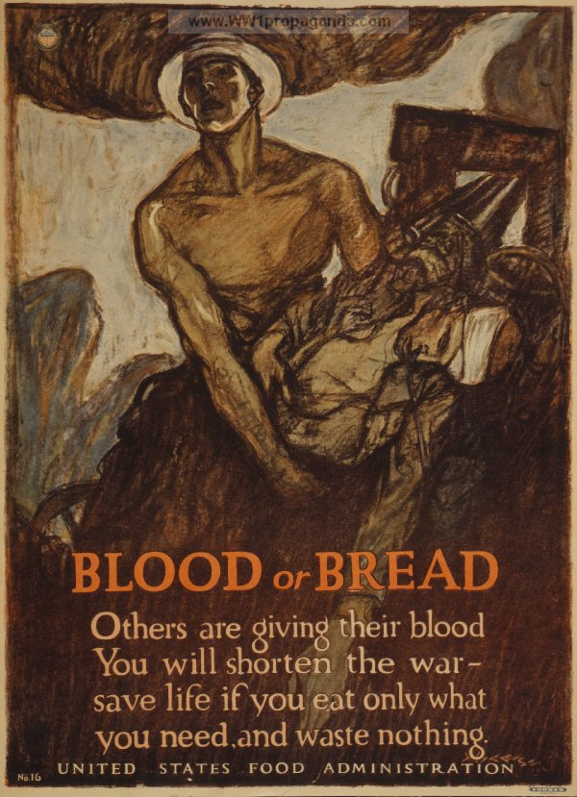
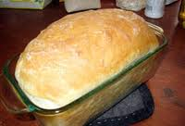
War Info – Food Shortages
As the fighting wore on, all of the participating nations experienced food shortages. In response,
wartime governments in Europe instituted food rationing, which led to long lines at stores for what little food was available. In Germany, shortages were especially severe because the Allies had blockaded German ports.
With little grain available, turnips and potatoes were used to make krieg (war) bread, and acorns were gathered and ground up to make coffee. By the winter of 1916–1917, German citizens were becoming weak and thin, and some were dying from starvation.
How does this relate to where we find Paul at the end of chapter 8?

Slide 30
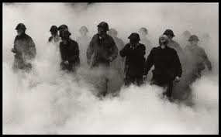
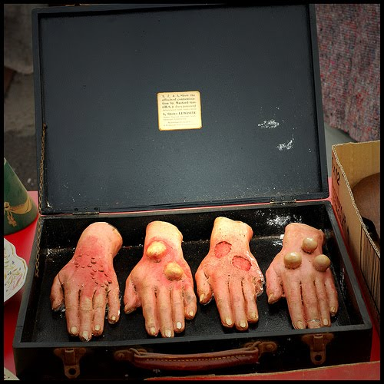
War Info – Gas
The Germans were the first to use poison gas on a large scale. At the Second Battle of Ypres in April 1915, German soldiers in a front-line trench released chlorine gas from more than five thousand pressurized cylinders, timing the release with a westward-blowing wind. Chlorine gas, visible as a greenish-yellow cloud, is a lung irritant that causes extreme pain in the nose and throat and slow suffocation. Death results if the concentrated gas is inhaled for more than a few minutes.
Many people thought the German’s use of poison gas was barbaric, but the British and French quickly developed their own gas weapons. The most widely used gas, mustard gas, was introduced in mid-1917. Odorless and colorless, it burned the skin, eyes, and respiratory tissues. Gas attacks caused at least one million deaths during the war. After gas masks were developed, few men were killed by gas, but gas attacks were still used to unsettle the enemy.

Slide 31
Chapter 9
1) How do the men prepare for the Kaiser’s visit? Who is the Kaiser?
2) The men have a discussion about who starts war – What conclusions do they reach?
They are issued all new uniforms (to borrow), and there are so many drills and attention to perfection. He is the “All-Highest”, the emperor of Germany.
That even if the Kaiser had said no to the war it would have happened because the government is more than one. They also conclude that the French believe that they are in the right just as much as they do. They decide that a war is started because the State (government) is offended by another country. Though they have been told that they are fighting for their fatherland, it is really for the political game that they are fighting, which they really have no vested interest in. They also speculate that the emperor may secretly want the war for a claim to fame in history books.

Slide 32
Chapter 9
3) What type of damage do trench mortars cause?
4) What happens to Paul on scouting duty? How is he saved?
How does he feel about his comrades?
They can blow you right out of your clothes/in half.
He gets lost in the trenches and looses his sense of direction therefore ending up on the enemy line. ? After killing Duval, he runs for safety from trench to trench during the cover of night until he finds Kat and Albert.

Slide 33
Chapter 9
5) Who is Gerard Duval? How is Paul affected by his death?
. Gerard Duval is a printer.
Paul talks to the dead man about how he did not want to kill him but only did because he jumped into the trench nearly on top of Paul. He talks to him about how they were only enemies because of the uniforms that they wore. He asks Gerard for forgiveness. Paul vows to help his wife and children. He will write to them (or so he says until he reads their letters and is too stricken by guilt and pain). He vows to be a printer when he returns to civilian life as Gerard was and to live for Gerard and his family alone.

Slide 34
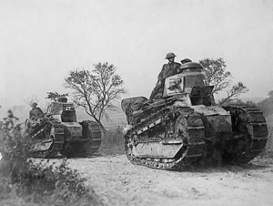
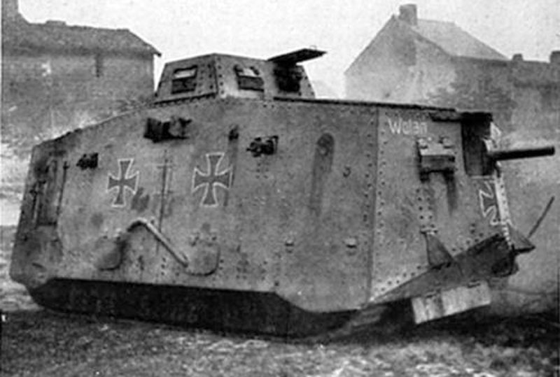
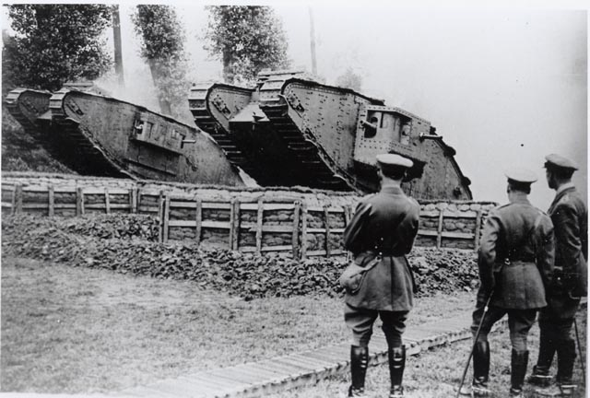
War Info – Tanks and Trench Warfare
The Allies, as well as the Germans, designed new weapons to try to break the deadlock of trench warfare. The British thought that tank warfare would be the solution. Tanks could easily roll over barbed wire and cross trenches up to ten-feet wide, clearing the way for advancing infantry. Tanks were prone to breakdowns, however, and often got stuck in the mud.
British tanks were first used in 1916 at the Battle of the Somme. Looking like “mysterious monsters” that nothing could stop, tanks incited fear in the enemy, but there were too few of them to make a significant impact. Later in the war, the Allies launched two massive tank attacks. Both attacks used over three hundred units and were successful in breaking through German lines. Great Britain deployed almost three thousand heavy tanks between 1916and 1918, while the Germans used only twenty.

Slide 35
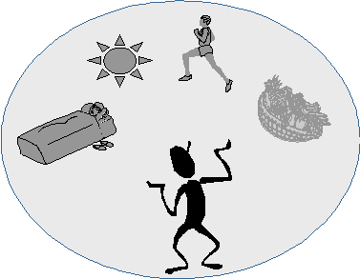
Chapter 10 Book Review - Psychology and War Connection
When people are under severe stress or dealing with strong negative emotions, they often fall back on certain coping strategies. Also called defense mechanisms, these strategies may temporarily protect a person from painful situations or thoughts, but they usually do not work as long-term solutions. Read the definition of the following coping mechanisms and find two specific examples with page numbers from the text.
Coping Mechanism | Example of Mechanism in the Novel with Page #
1) Denial or refusing to recognize an emotion or problem.
2) Compensation, or making up for a weakness in one area by excelling in another.
3) Daydreaming, or inventing situations to escape unpleasant facts.
4) Displacement, or transferring emotions from the true source to some other thing or person.
5) Rationalization, or making excuses for one’s actions or feelings.
6) Regression, or returning to immature behavior to express emotions

Slide 36
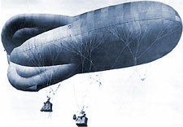
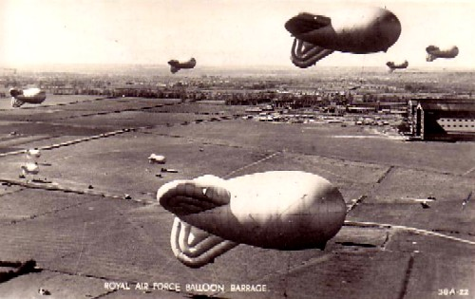
Chapter 10 Summary
Paul Kat, Albert, Müller, Tjaden, and Detering guard a supply dump.
They choose a concrete cellar to live in – it's well protected with concrete walls, floor beds, and furnishings.
The men find and cook baby pigs, but the smoke from cooking is spotted by enemy balloons.
The men wait over 5 hours but survive. "the town gradually vanishes under the shells and we lead a charmed life.”
The men evacuate a German village of civilians.

Slide 37
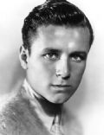
Chapter 10 Summary
We are marching in column; the French certainly will not fire on a town in which there are still inhabitants. But a few minutes later the air screams, the earth heaves, cries ring out; a shell has landed among our rear squad. We scatter and fling ourselves down on the ground, but at that moment I feel the instinctive alertness leave me which hitherto has always made me do unconsciously the right thing under fire; the thought leaps up with a terrible throttling fear: "You are lost"--and the next moment a blow sweeps like a whip over my left leg. I hear Albert cry out; he is beside me.
"Quick, up, Albert!" I yell, for we are lying unsheltered in the open field.

Slide 38
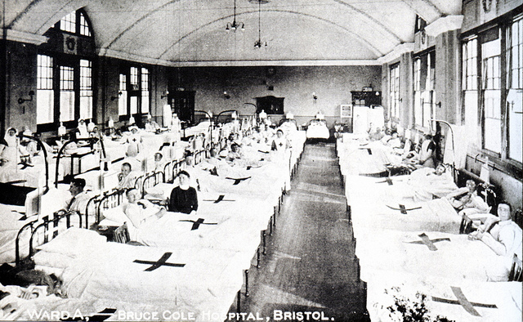
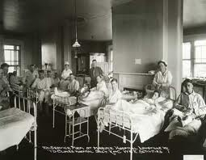
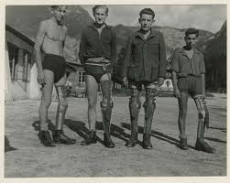
Chapter 10 Summary
Paul was injured a bit, presumably by shrapnel, and he is bleeding.
That night, they are taken to surgery (which Paul calls "the chopping block"). Paul has no trust in the surgeons and is determined not to receive chloroform (to knock him out so he doesn't feel the pain), even if he has to "crack their skulls."
Paul is going to be sent home because of his injuries but bribes a guard to send him back to the front line with Albert.
Paul and Albert spend a good amount of time at a bandaging ward.
"Many a man has said that. Once a man is in there, he never comes through"
Albert’s leg is amputated.
Paul is in rehabilitation for his broken are and leg.
Paul is sent to the Front at the end of the chapter.

Slide 39
Chapter 11
Literary Devices | Word Choice | Emotion | Makes You Think | Imagery
Quote | Purpose & Tone
Six months ago he would not have cared, he would have been reasonable. We try to prevent him. Then, as he goes off grimly, all we can say is: "You're mad," and let him go. For these cases of front-line madness become dangerous if one is not able to fling the man to the ground and hold him fast. And Berger is six feet and the most powerful man in the company. He is absolutely mad for he has to pass through the barrage; but this lightning that lowers somewhere above us all has struck him and made him demented. It affects others so that they begin to rave, to run away--there was one man who even tried to dig himself into the ground with hands, feet, and teeth.

Slide 40
Chapter 11
Literary Devices | Word Choice | Emotion | Makes You Think | Imagery
Quote | Purpose & Tone
The anguish of solitude rises up in me. When Kat is taken away I will not have one friend left. Perhaps we could do something together later on, Kat." I am very miserable, it is impossible that Kat--Kat my friend, Kat with the drooping shoulders and the poor, thin moustache, Kat, whom I know as I know no other man, Kat with whom I have shared these years--it is impossible that perhaps I shall not see Kat again.

Slide 41
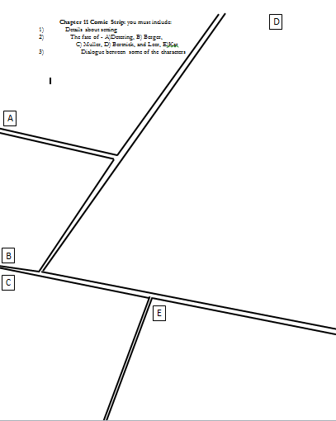
Chapter 11 Comic
Divide you page up into 5 different comic blocks.
You must include:
1) Details about setting
2) The fates of - A)Detering,
B) Berger,
C) Muller,
D) Bertnick, and Leer,
E)Kat
3) Dialogue between some of the characters

Slide 42
Created by Eric Junco
Would you like classroom t-shirts , awards and / or other personalized merchandise for your class, athletic team, or club?
Please go to www.erical.com for up to a 30 % discount!

