Slide 1
This project and its actions were made possible due to co-financing by the European Fund for the Integration of Third-Country Nationals
EAL Nexus resource
Macbeth Act 2
Key words
Subject: | English
Age ranges: | 11–14, 15–16
Topic: | Macbeth
Licence information | This resource is free to use for educational purposes. ©British Council 2015
Source | This resource was originally developed by Ruth Wilson for Wolverhampton Local Authority and has been adapted by EAL Nexus.

Slide 2
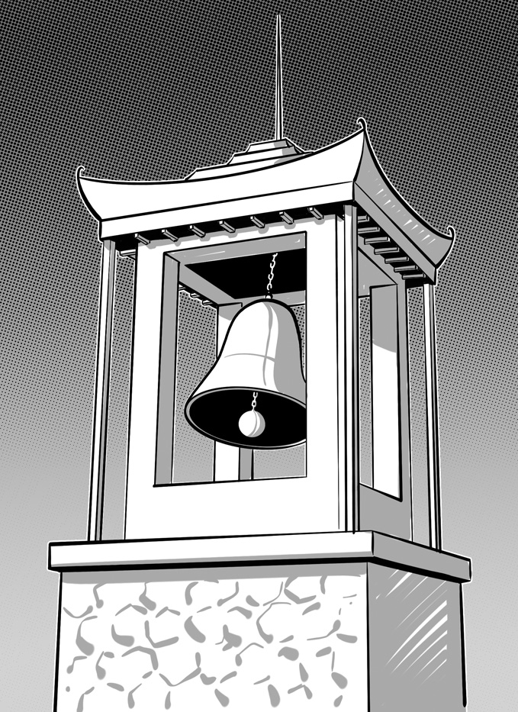
the bell
the bell tower

Slide 3
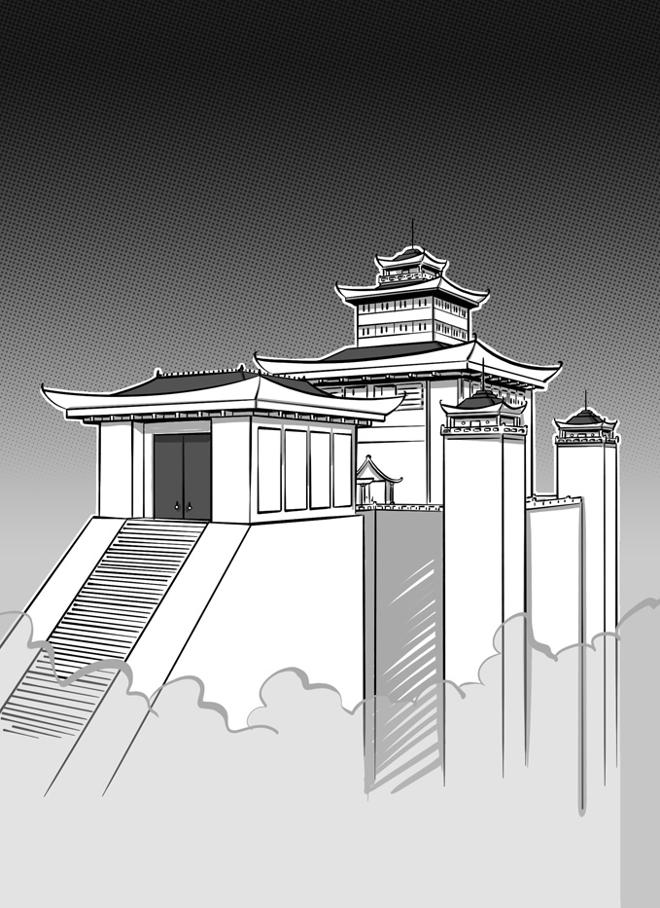
the castle
the gate

Slide 4
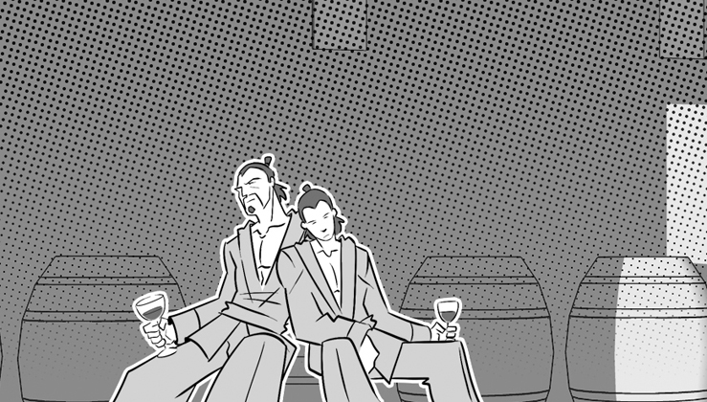
the two grooms

